Slide 1
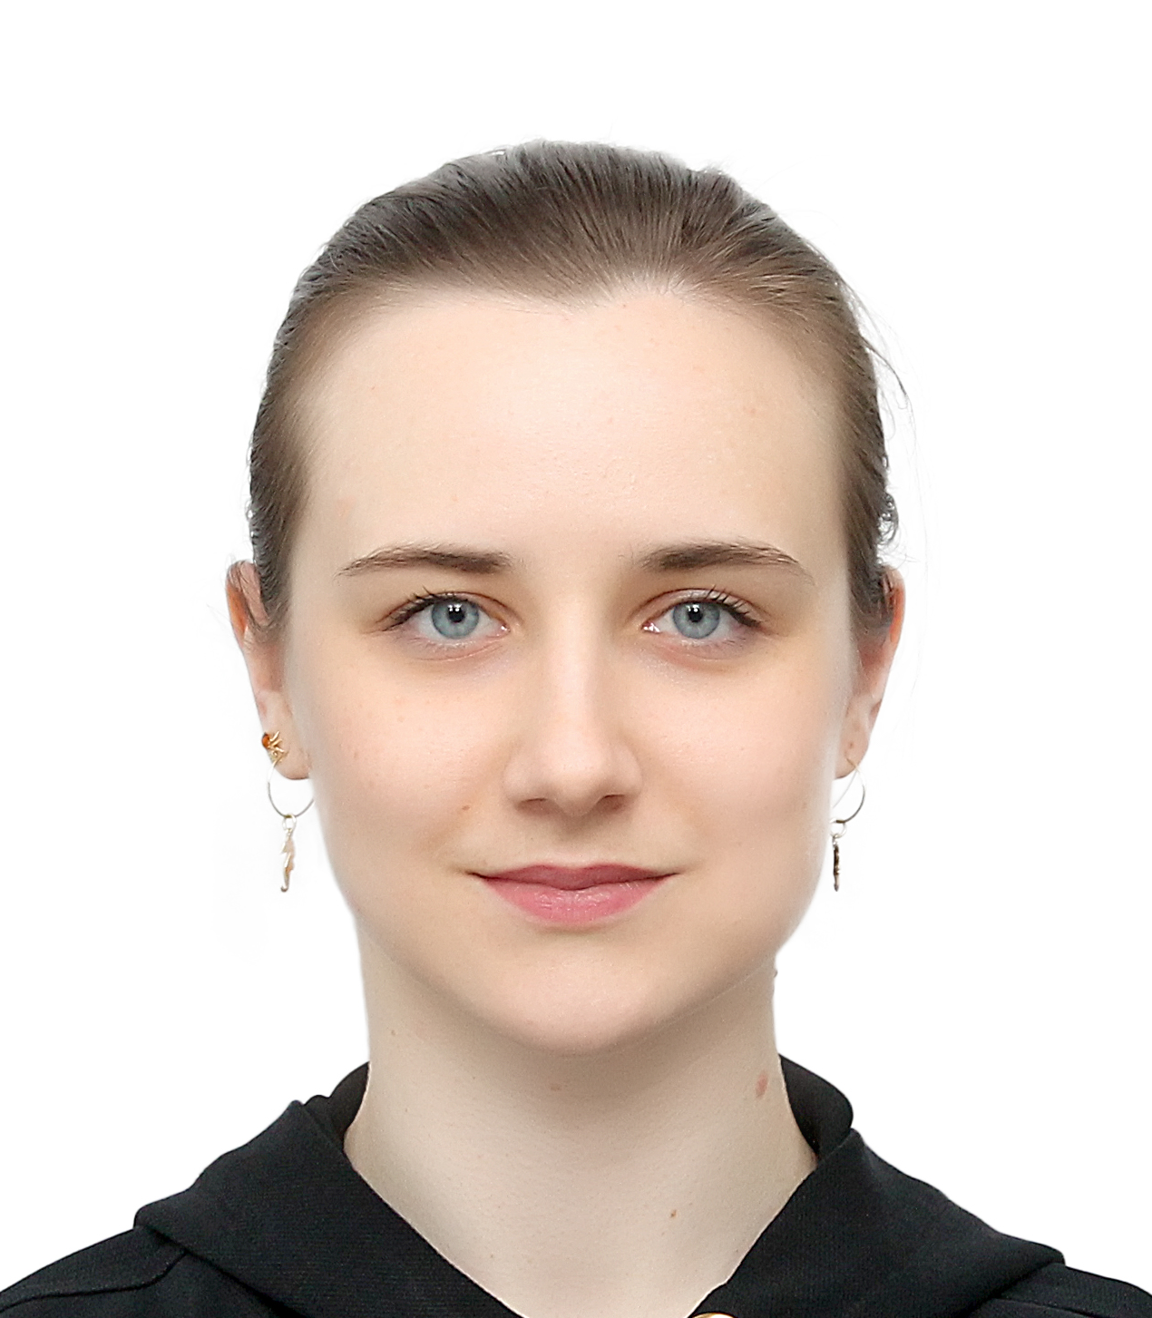
Varvara
Lazarenko
Address
Telephone
E-mail
Date of birth
LinkedIn
Nijmegen, The Netherlands
+31 6 2662 9839
varlazoa@gmail.com
29.12.1998 (26 years)
www.linkedin.com/in/varvara-lazo
PERSONAL STATEMENT
I am a highly motivated and hardworking graduate with a Master’s degree in Medical biology. Having worked in fundamental research setting as well as in clinical trials development, I am inspired by the societal & business aspects of healthcare innovations. In my career, I aspire to engage with a diverse range of clients and provide them with strategic advice tailored to their unique needs.
EDUCATION
09/2022 – 08/2024
MSc in Medical Biology – Radboud University, Nijmegen, The Netherlands
Specialisation: Science, Management and Innovation
GPA 7.63/10.00
Principal subjects: Future of health, How Health Systems Work, Sustainable Innovation Management, Methods in Societal Research, Reaching the Sustainable Development Goals
Projects: «HTA of a Medical Guidance App for International Students in the NL»
«A Shared Ownership Model of the Green Corridor, Nijmegen»
«A Circular Alternative to Single-Use Cups Within the Dutch Train System»
Master thesis: «Potential added value of home telemonitoring technology in elderly care»
BSc in Biology – Lomonosov Moscow State University (MSU), Moscow, Russia
Specialisation: Human and Animal Physiology
GPA 4.83/5.00
Principal subjects: Human and animal physiology, Electrophysiology of excited cells, Neurochemistry, Physiology of central nervous and visceral systems, Physiology of circulation, Virology, Microbiology
Bachelor thesis: «Role of TASK-1 channels in arterial tone regulation in different organs in rats»
09/2016 – 06/2020
WORK EXPERIENCE
02/2024 – 08/2024
Intern at Digital Transformation of Rehabilitation Care
HAN University of Applied Sciences – Nijmegen, The Netherlands
Added value research of home telemonitoring in elderly care based on the HTA framework presented onto the Quadruple aim
Communication with >10 hospitals and medical associations
Deployment of surveys (22) in Dutch and interviewing (7) medical professionals in English on their home telemonitoring experience/attitude
Cost-effectiveness analysis (Markov model cohort simulation) on home telemonitoring in the Netherlands
Intern at Neuronal Networks of Memory
Donders Institute – Nijmegen, The Netherlands
In vivo Ca²⁺ imaging of the retrosplenial cortex in mice during head-fixed virtual social learning
Management of laboratory animals (mice, handling & feeding)
Computational analysis of the obtained data (Python, DeepLabCut)
02/2023 – 08/2023
1

Slide 2
08/2021 – 08/2022
Assistant at the Science department of the Contract Research Organization
LABMGMU, LLC – Moscow, Russia
Developing clinical trial design, synopses, protocols, investigator’s brochures for >35 phase I, II, III clinical trials and bioequivalence trials
>30 user interviews (testing the readability of pharmaceuticals’ package leaflets)
Project management (control of the deadlines; compliance with the sponsor’s requirements)
Computational analysis of the obtained data (STATISTICA, GraphPad Prism)
10/2020 – 10/2021
Junior Research Assistant at Faculty of Biology
Lomonosov Moscow State University – Moscow, Russia
Physiological and molecular biology experiments (wire myography, real-time PCR, western blot)
Management of laboratory animals (Wistar rats)
Statistical analysis of the obtained data (STATISTICA, GraphPad Prism)
Project management (experiment and research strategy planning)
Presentation of the results at two conferences (Oct, 2020; Apr, 2021)
DIGITAL SKILLS
Python (beginner), DeepLabCut, STATISTICA, GraphPad Prism and MS Office softwares
LANGUAGES
Russian (native), English (fluent – С₁₋₂), German (intermediate – В₁-В₂), Dutch (low intermediate – А₂-B₁), French (beginner – А₁)
ACADEMIC HONORS AND AWARDS
2022-2024
2020-2021
2021
Awarded Orange Tulip Scholarship for the studies at Radboud University
Awarded MSU Increased State Academic Scholarship for scientific and academic achievements
Second prize-winner in the Lomonosov Universiade on modern problems of biology
CERTIFICATES
2023
2021
A course on ex. Art. 9 of the Dutch Act on animal experimentation, Radboudumc
An upgrade training on ICH GCP guidelines, LABMGMU
VOLUNTEERING ACTIVITY
08/2024
05/2023
2022-2023
2018-2021
Mentorship of international exchange and Master’s students at the Radboud Intro
Organization of the BBB Career Event 2023, Nijmegen
Organization of volleyball tournaments in the international volleyball group at Radboud
Mentorship of first-year students at Faculty of Biology, MSU, Moscow
HOBBIES
Volleyball, drawing, guitar playing, traveling
JOURNAL PUBLICATIONS
Available upon request
2

